Slide 1

Accenture #2 - Fraud Detection (Team A)
AI Studio Final Presentation
Break Through Tech Los Angeles @ UCLA December 6th 2023

Slide 2

Introductions

Slide 3

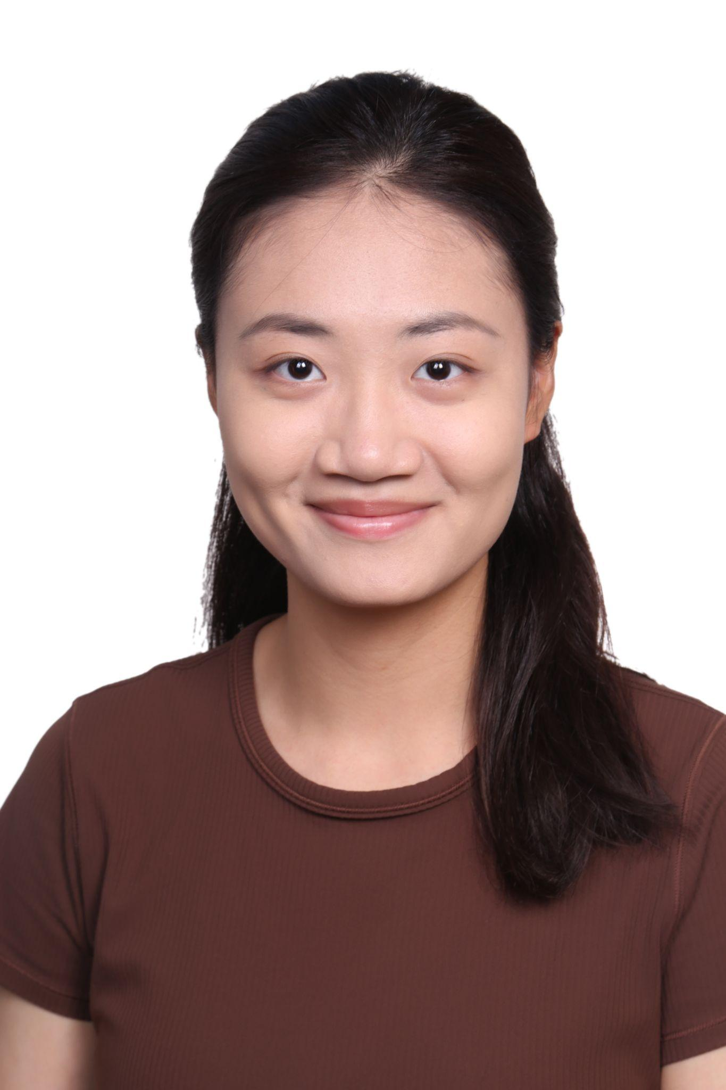

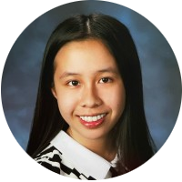
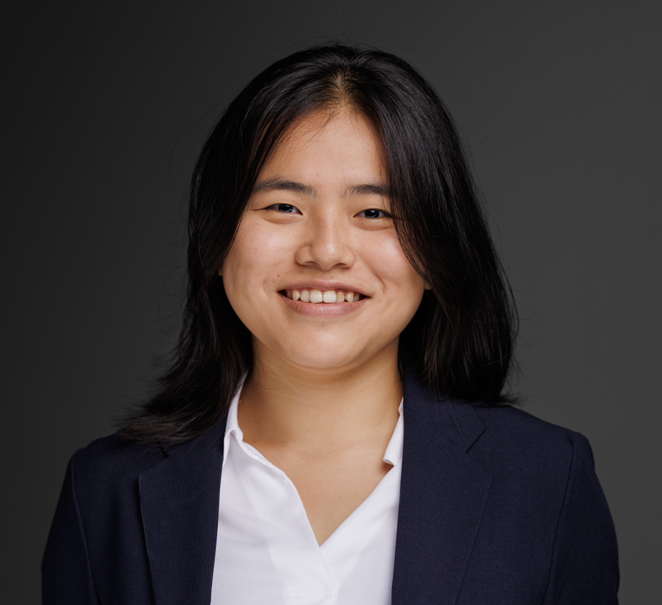

Meet Our Team!
<insert jpg>
Melissa Wang UCLA
Katelynn Nguyen Cal State Long Beach
Bernice Tran Cal Poly Pomona
<>
<insert jpg>
Yuqing Yang USC
Shannon Stack UC Irvine

Slide 4

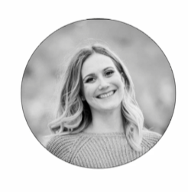

Our AI Studio TA and Challenge Advisors
Vaibhav Tiwari
AI Studio TA
Rachel Cabrera Challenge Advisor
Brendon Ngo
Challenge Advisor

Slide 5
Presentation Agenda
Introductions
AI Studio Project Overview
Data Understanding & Preparation
Modeling & Evaluation
Final Thoughts
Questions

Slide 6
AI Studio Project Overview

Slide 7
“
Hypothetical “real-world” scenario: A banking client approaches our firm to help them predict fraudulent transactions. Select an appropriate supervised learning method to classify transactions. Help our client understand the overall accuracy of this approach, false positive rate, false negative rate, and the probability that an instance represents fraud given a positive prediction. Supervised Learning: Binary Classification

Slide 8

Our Goal
Create a model that detects whether a transaction is fraudulent or not fraudulent
Select an algorithm by considering the factors that are likely to make some methods better than others
Apply our model back to the business goal

Slide 9

Business Impact
Enhancing the customer’s trust
Competitive advantage
Adaptable to future threats
Protecting revenue
Reducing cost
Notes:
Elaborating:
Enhancing the customer’s trust - Making sure the banking client create trust with their customers. Detecting fraud will help the security and protection for their customers personal information (DOB, card information, email, location, etc.)
Reducing cost

Slide 10
Our Approach
Business Understanding
Meet and greet at Accenture office
Identifying project scope
Planning next steps
Data Preparation/Modeling & Evaluation
Finishing data preparation
Choosing different models to try
Logistic regression
K-Nearest neighbors
Decision Tree
GBDT
SVM
Sept 2023
Nov 2023
Aug 2023
Oct 2023
Data Preparation
Missing values
One-hot encoding
Creating batches
Choosing features
Modeling & Evaluation
Choosing metrics to evaluate models
AUC, precision/recall, f1, confusion matrix, etc
Adjusting models, hyperparameter tuning
Comparing models

Slide 11








Resources We Leveraged

Slide 12
Data Understanding & Data Preparation

Slide 13
Data Cleaning & Exploratory Data Analysis
About 600,000 data observations
Missing values
Columns with email domain info
Text columns

Slide 14
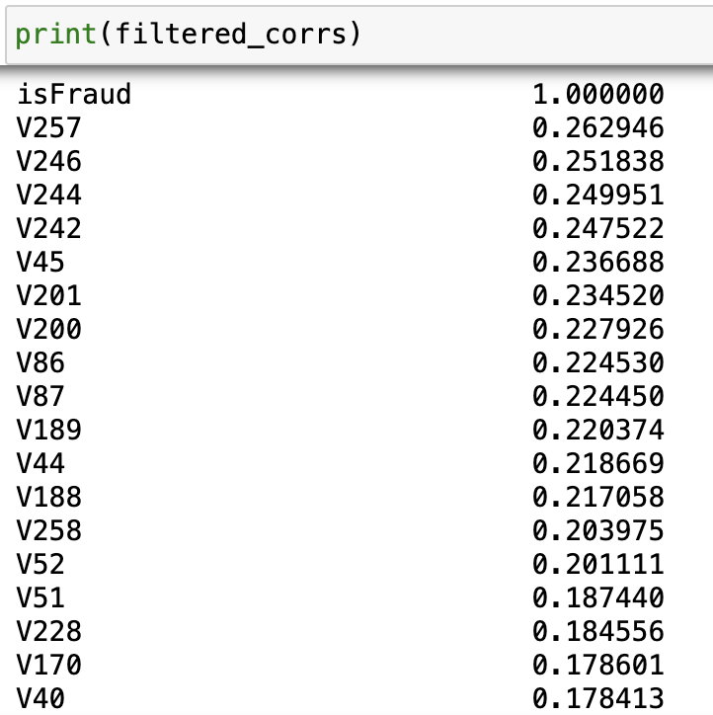
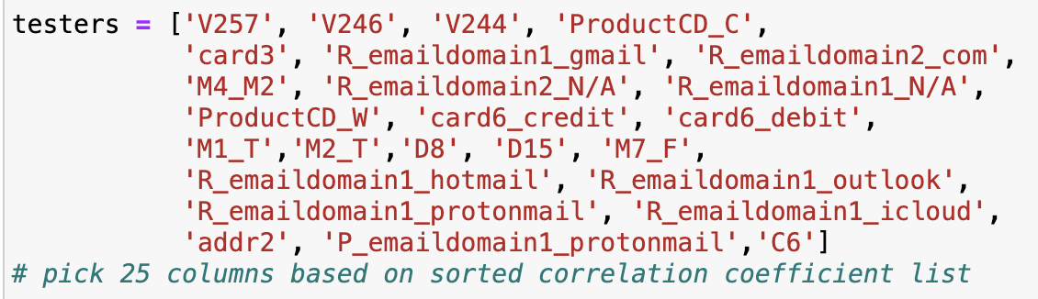
Feature Selection
Compute and sort our the correlation between the columns and the ‘isFraud’ label

Slide 15
Accuracy Metrics
Precision: TP/(TP+FP).It measures the accuracy of the positive predictions.
Recall: TP/(TP+FN). It evaluates how effective a model is at identifying relevant instances.
F1 Score: 2 * (Precision * Recall) / (Precision + Recall). Balance between precision and recall. It is particularly useful when the distribution of the classes is uneven.
AUC: The higher the AUC, the better the model is at distinguishing between positive and negative classes.

Slide 16
Modeling & Evaluation

Slide 17
Model Comparison
Model Name | Description | Pros | Cons
Logistic Regression | Predict probability of binary classification using logistic function | High accuracy Suitable for large dataset | High false positive rate Low F1 score
K-Nearest Neighbors (KNN) | Versatile algorithm that works well with binary classification | High accuracy and AUC scores | Low F1 score Would be effective for smaller datasets
Support Vector Machine (SVM) | Supervised learning model that uses classification algorithms for binary classification | Good for large datasets Low false negative rate | High false positive rate Low F1 score
Decision Trees | A non-parametric supervised learning algorithm for both classification and regression tasks | High Precision + AUC | High False negative rate
Gradient Boosted Decision Tree (GBDT) | An iterative model that progressively refines its predictions by combining multiple decision trees | Handles imbalanced data Reaches high accuracy score | - Prone to overfitting - Hard to tune hyperparameters

Slide 18
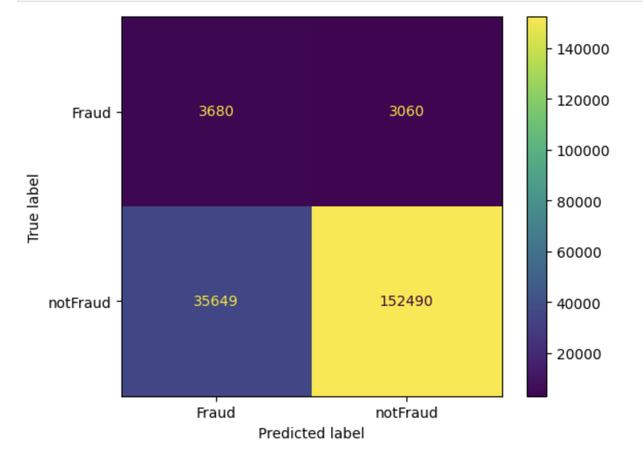
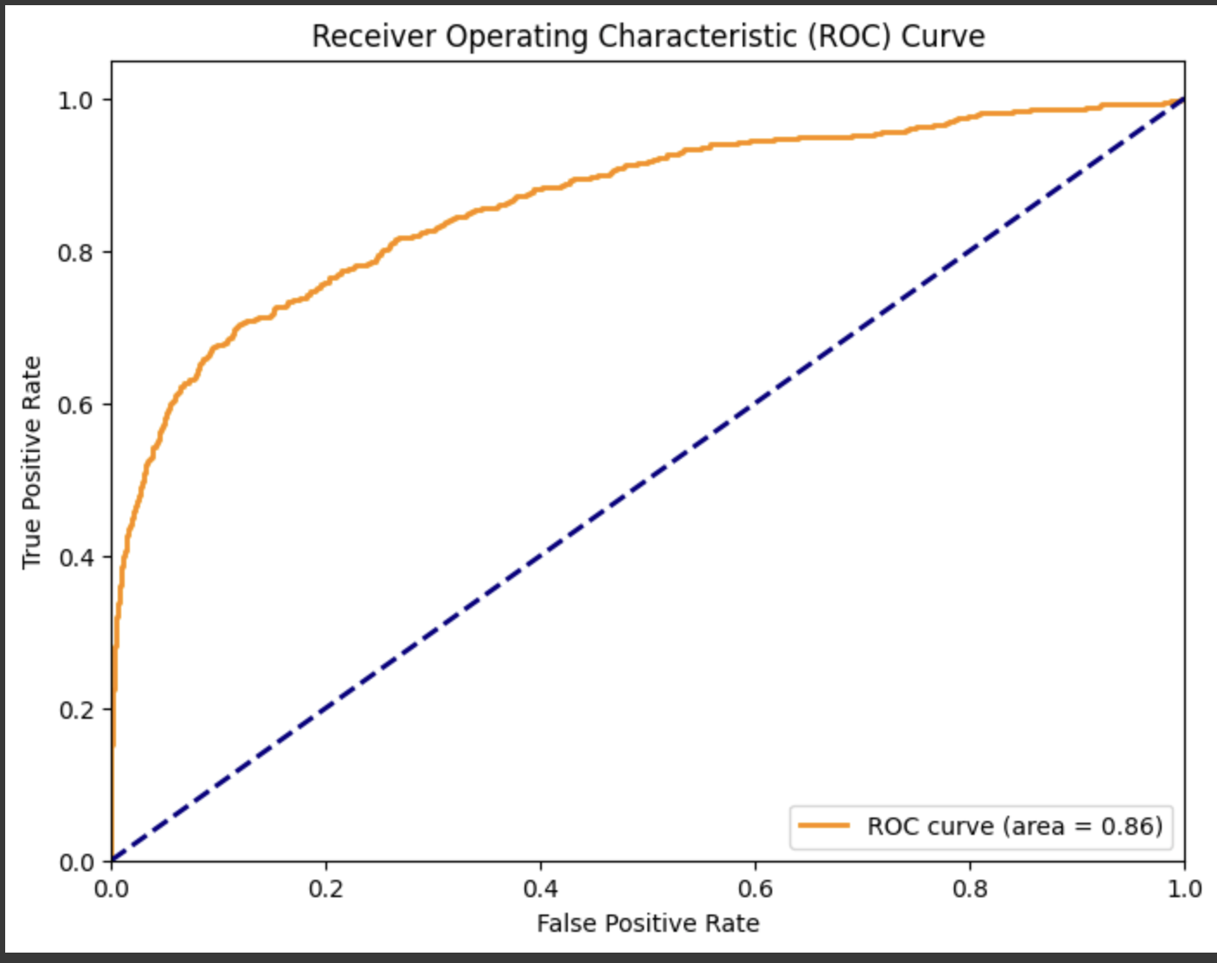
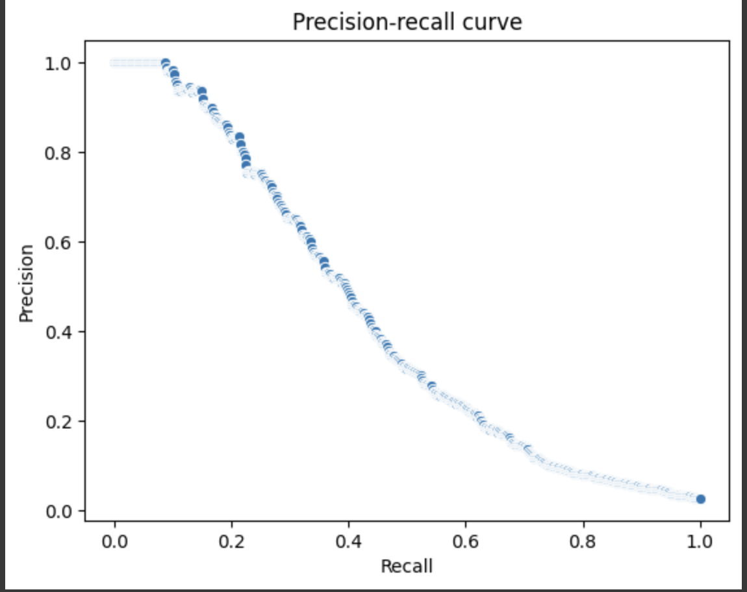
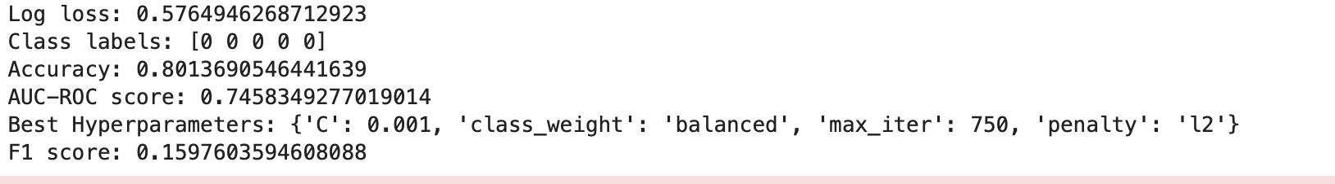
Insights and Key Findings - Logistic Regression
FP rate: 0.18948224
FN rate: 0.45400593

Slide 19
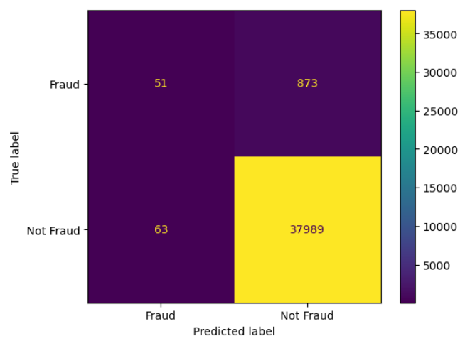
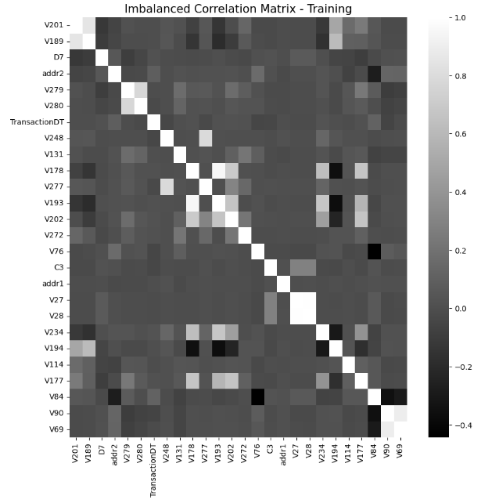
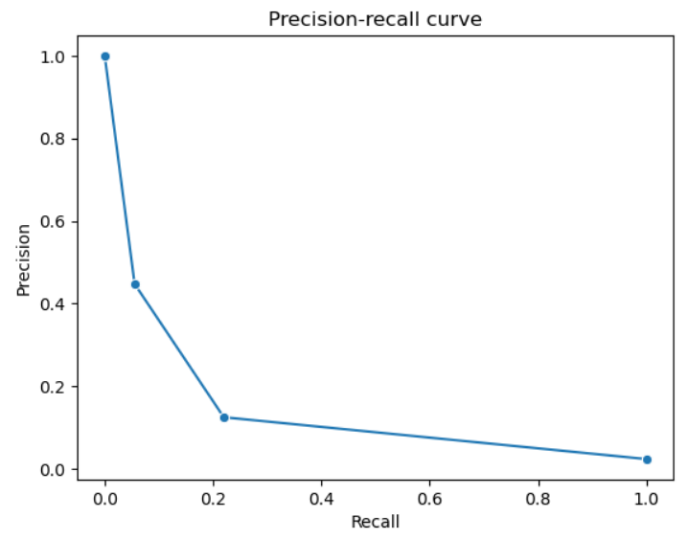
Insights and Key Findings - KNN
Worked in batches of 50,000
Accuracy: 0.9759
AUC-ROC: 0.70
F1 Score: 0.24
False Positive (FP) = 0.00165
False Negative (FN) = 0.9448

Slide 20
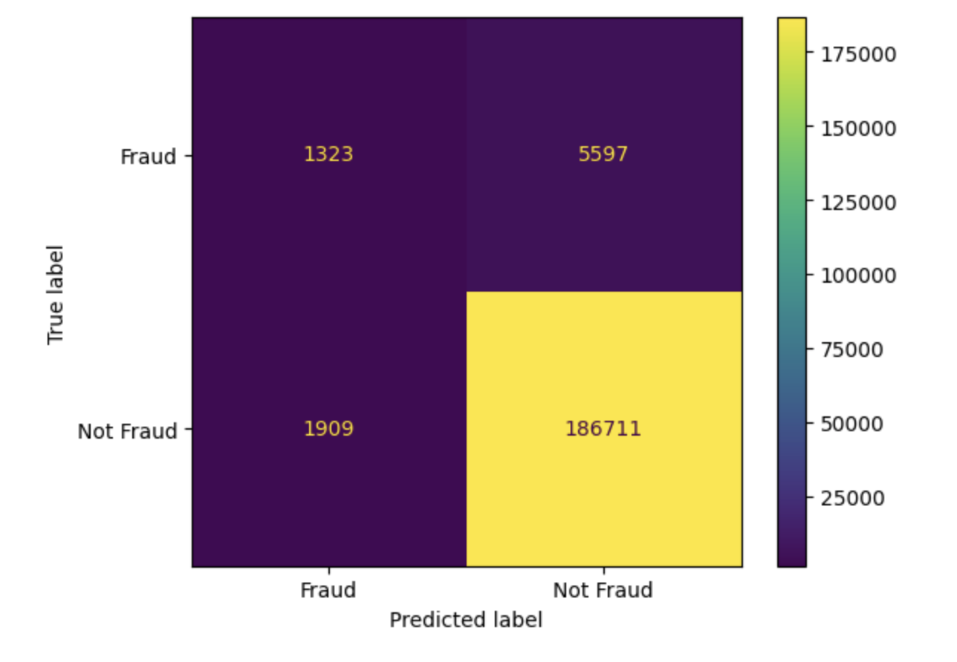
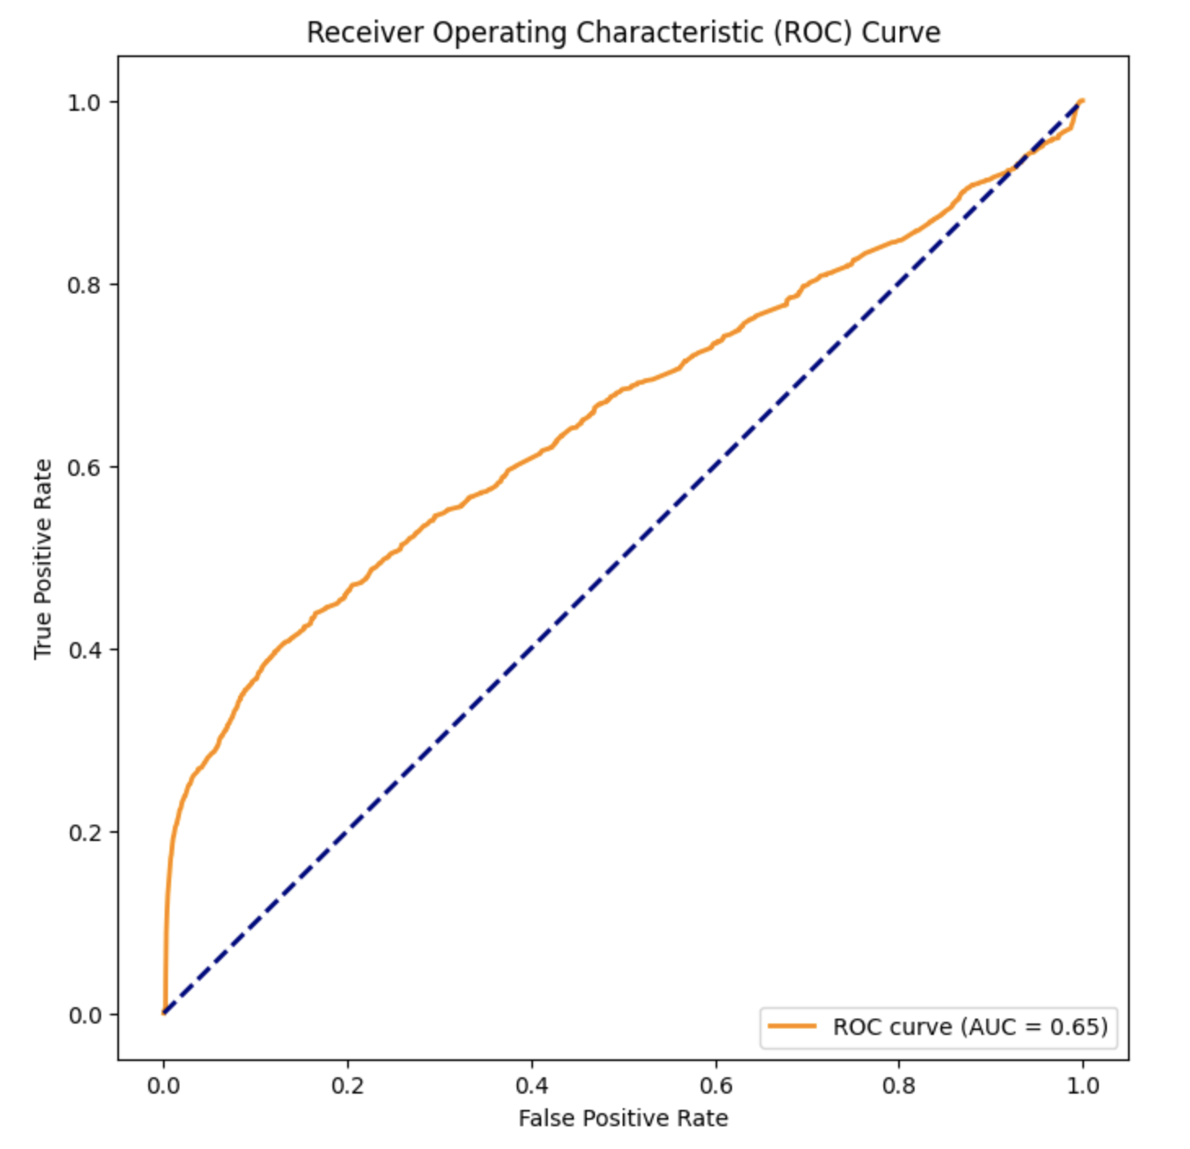
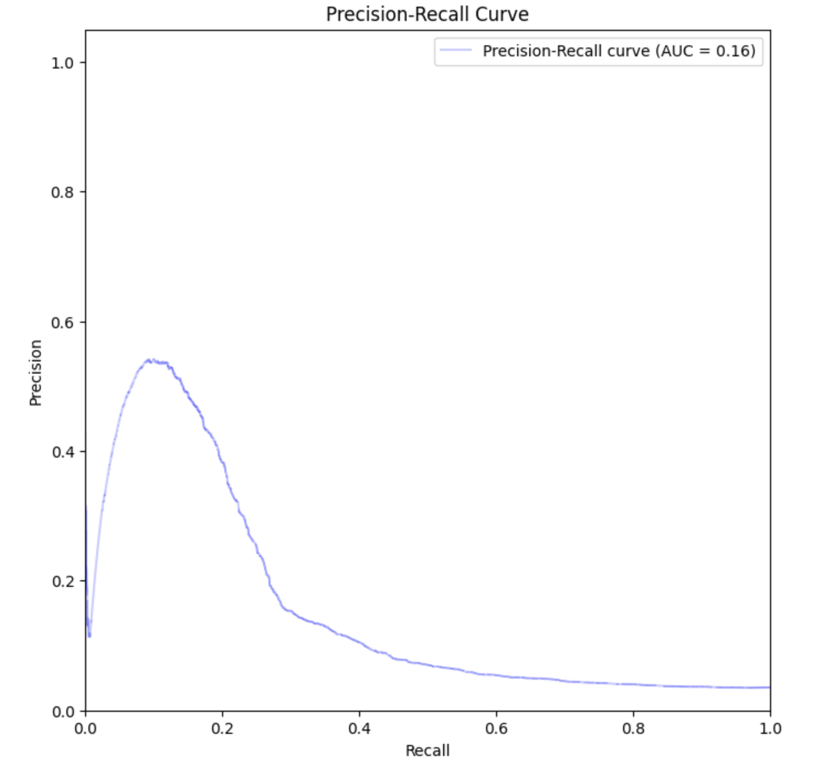
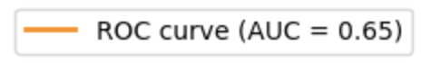
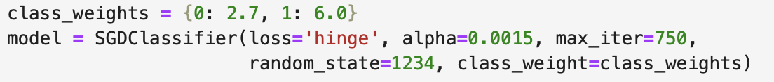
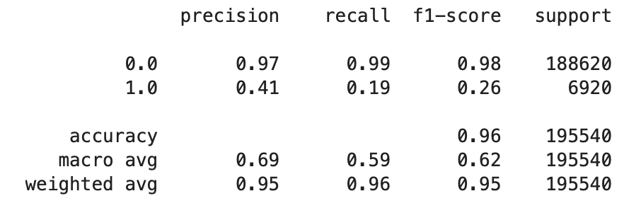
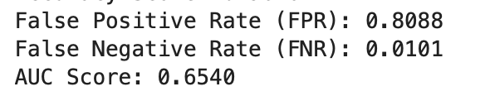
Insights and Key Findings - SVM
Notes:
Class weights to deal with imbalance
SGDClassifier to incrementally fit an svm model
Handle large dataset by dividing into batches

Slide 21
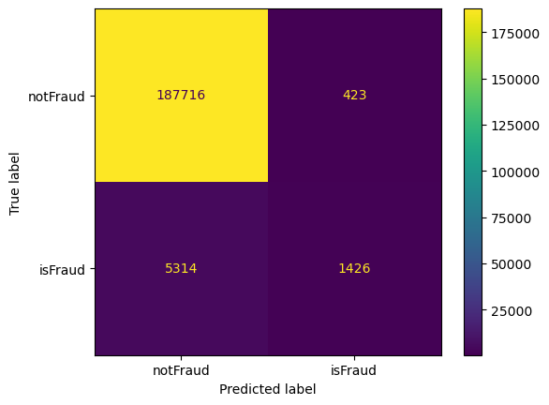
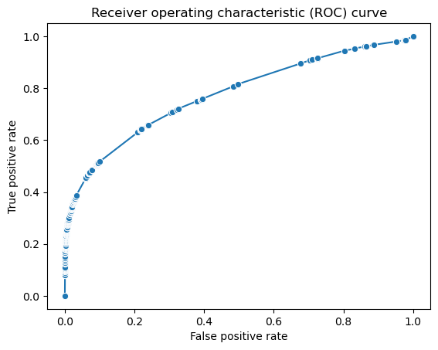
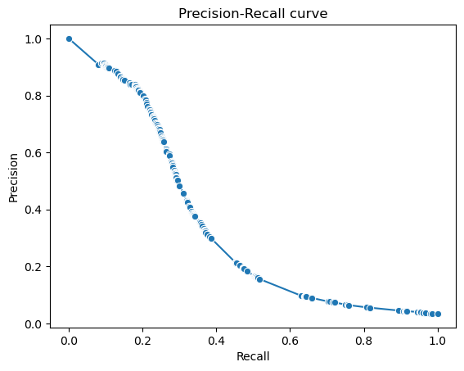
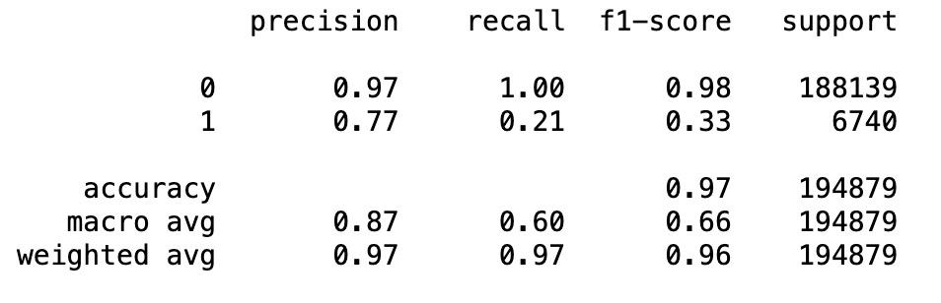
Insights and Key Findings - Decision Tree
AUC=0.77
Precision=0.77; Recall=0.21; F1_Score=0.33

Slide 22
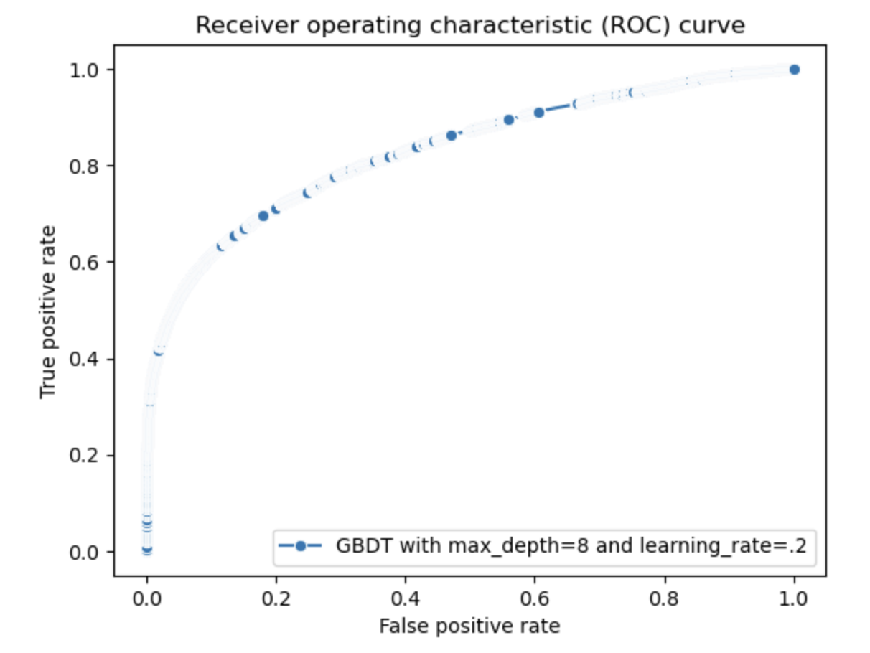
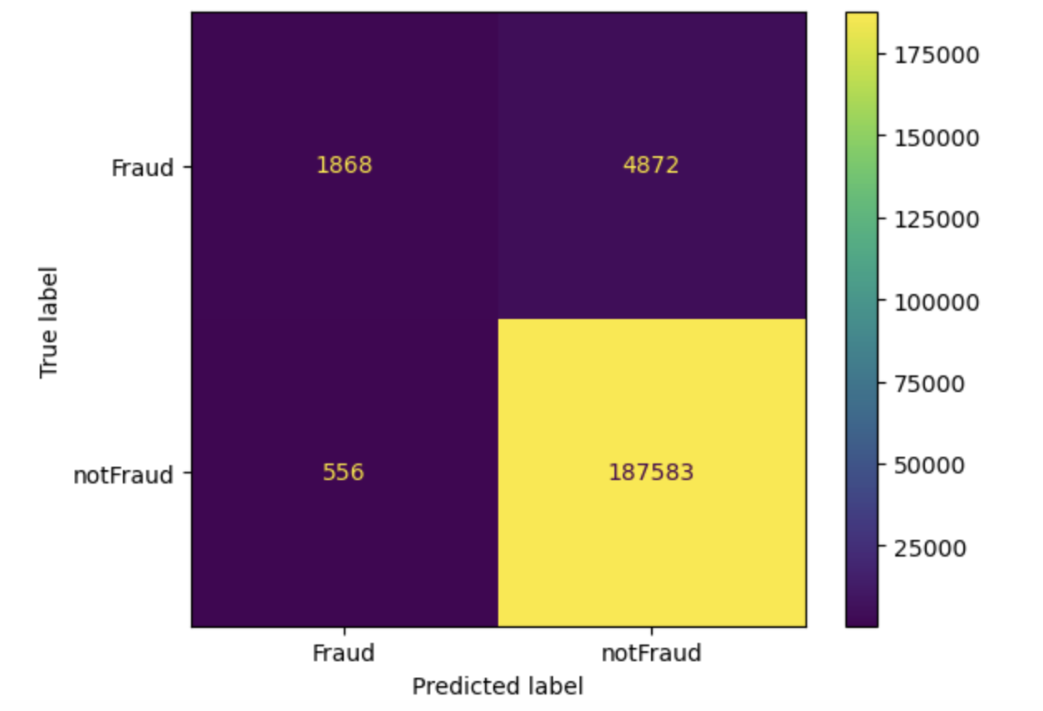
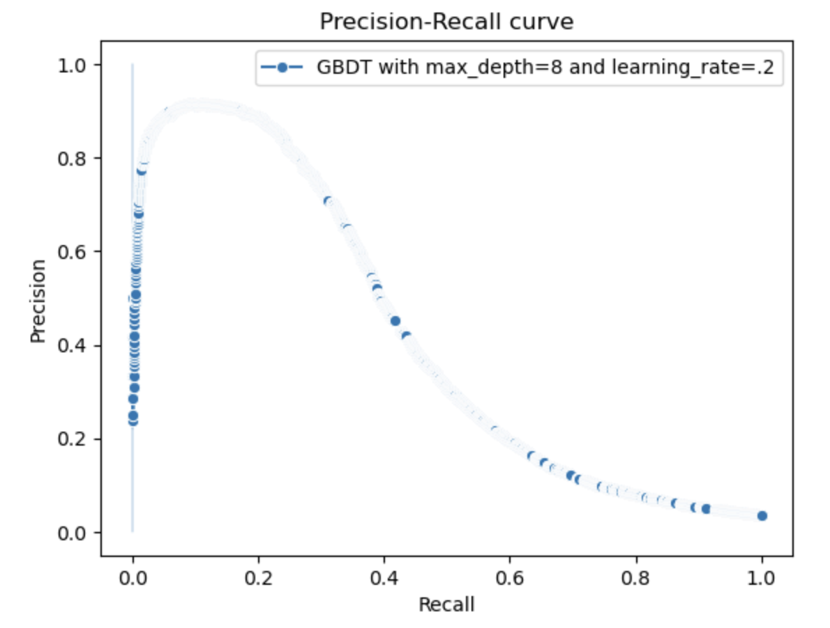
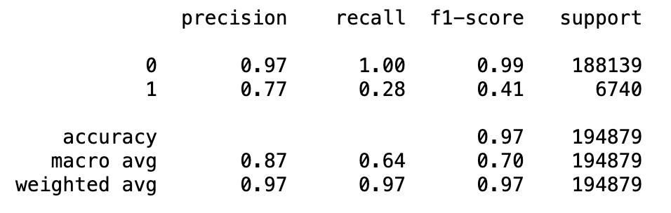
Insights and Key Findings - GBDT
AUC = 0.831
learning rate = 0.2, max depth = 8
AUC = 0.418
True Positive Rate: 0.28; False Positive Rate: 0.0029

Slide 23
Final Thoughts

Slide 24
What We Learned & Challenges We Faced
Working with large dataset of 600,000+, causing crashes
Time conflicts for team meetings fluctuated
Support Vector Machine (SVM)
Configuring the AUC curve

Slide 25
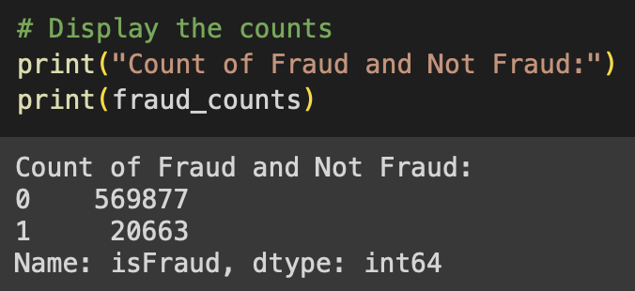
Potential Next Steps
Refine our current models (hyperparameter tuning)
Try out and learn more models that help to adjust class imbalance
(e.g Naive Bayes Alg)
Train our models on the testing dataset

Slide 26

Questions?

